Slide 1

Automated user state detection
Carlotta May, Marlon Spiess

Slide 2

Introduction in Automated User State Detection
Background
Emotions
FER
Table of Contents
Methodology
Literature
Tools
Implementation
Results
Identified List of Tools
Selection criteria and decision
Simulation of use case with Prototype
Reflection & Limitations

Slide 3
IntRoduction
01

Slide 4
Automated User State Detection
People may not always tell the truth, but emotions reveal their real thoughts
Understanding the user‘s wishes is key to marketing, customer satisfaction and building strong connection
→ Extract users emotion and stress level during the use of a certain website / app
Physical Indicators | Non-Physical Indicators
Body language, gestures, facial expressions, pupil dilation, heart rate | voice pitch, word choice, tone variations, breathing patterns
Motion tracking, Facial recognition software, Eye-tracking, ECG (fitness tracker) | Speech analysis software, Sentiment analysis, Natural Language Processing
→ Emotions and stress level influence how we interact with software

Slide 5


Automated User State Detection: Use Case
Use Case: get to know the real opinion of a user
→ extract users emotions during the use of a certain website / app to discover processes and designs that can be improved (user satisfaction)
Focus: emotion detection using video data to analyze user states (non-invasive, widely used)

Slide 6
Background and Methodology
02

Slide 7
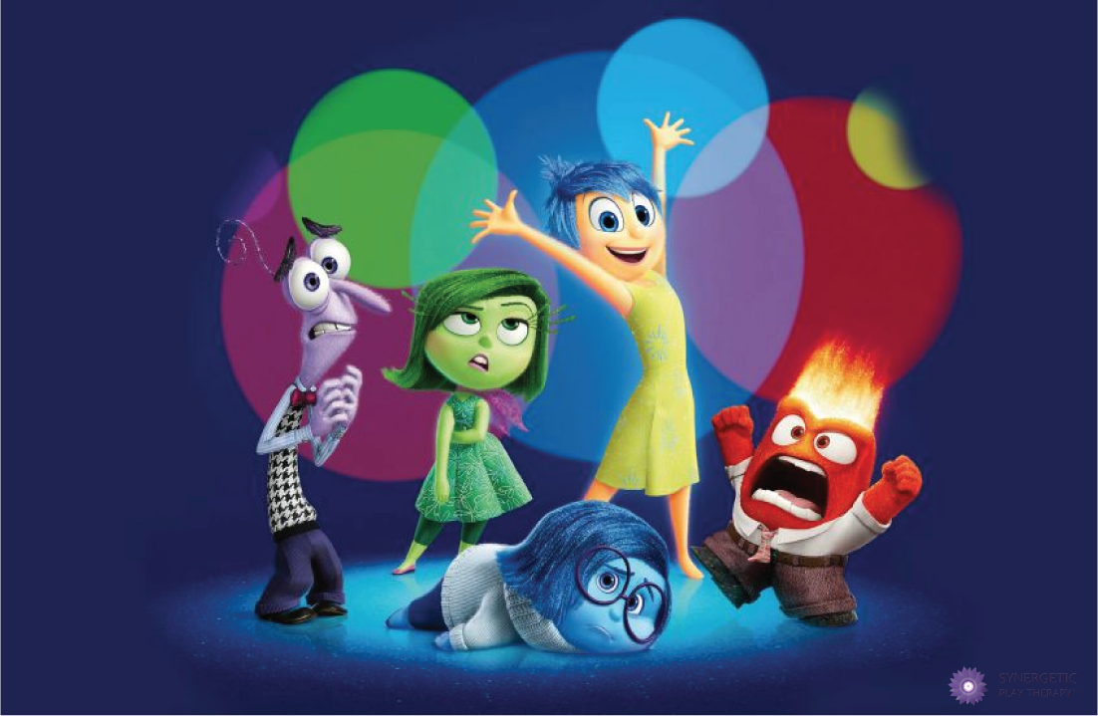
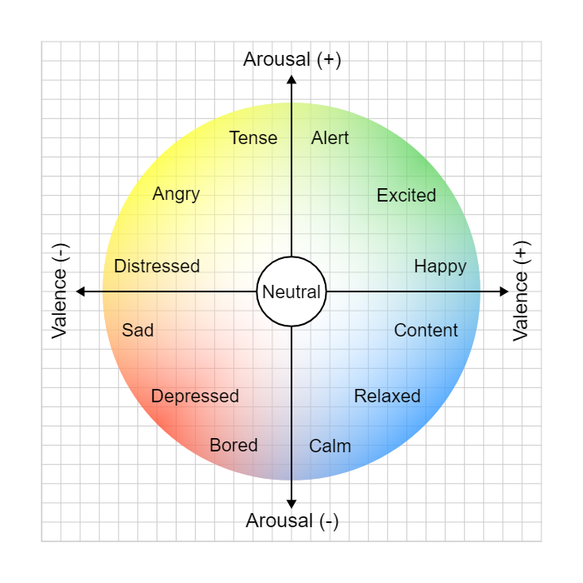
Definition: Emotions
Emotions = reaction to external influences or situations
effecting cognitive and physical responses (facial expressions, posture, speech
influencing decision making
Six fundamental emotions: joy, sadness, anger, fear, surprise and disgust (Paul Ekman’s theory of emotions)
Emotions in 2D space: valence (pleasantness) & arousal (intensity) (Russel’s circumplex of emotions)
[1]
[2] Russel‘s Circumplex of Emotions

Slide 8
Definition: Facial Expression Recognition
--> analyses facial expressions from images & videos to reveal information on one´s emotional state
Conventional Approach:
Preprocessing: detect face & preprocess input (e.g. noise reduction)
Feature Extraction: identify & extract facial features to serve as basis for classification (e.g. facial landmarks)
Emotion Classification: assign emotions from discrete set based on extracted features
e.g. SVM, Random Forest etc.
Deep Learning Approach:
End-to-end learning
Automatically derives features
Directly learns from raw input through neural networks
No need to manually
e.g. Convolutional Neual Networks (CNN), Long Short-Term Memory (LSTM) etc.
Input
Preprocessing
Feature Extraction
Output
Emotion Classification

Slide 9

Methodology
Literature review
Tool Review
Tool Implementation
Web search
GitHub Deep Dive
Research Papers
variety of tool types (API, libraries, modules, frameworks, web-apps)
Science databases
Title + abstract screening
Backward and forward search
selection of a tool for prototype
Simulation of video-based emotion recognition
→ key concepts and state-of-the art approaches
→ extensive list of tools
→ explorative prototype for certain use case

Slide 10
RESULTS: Tools
03

Slide 11

56 Tools total
most using neural networks as classification method
Real-time x facial x free = 11 Tools
For the implementation we chose DeepFace based on our selection criteria: real-time capability, free availability, python integration, and basic emotion detection functionality.

Slide 12
RESULTS: Prototype
03

Slide 13
Prototype: Use Case
Scenario: User interacts with an online shopping website
Searches for a specific product (e.g. blue jeans)
Adds the selected product to the shopping cart
Proceeds to checkout & payment process
Expected Outcome:
Insights into UX & satisfaction levels
Potential identification of pain points affecting emotional states
Goal: improve website usability & enhance customer satisfaction

Slide 14
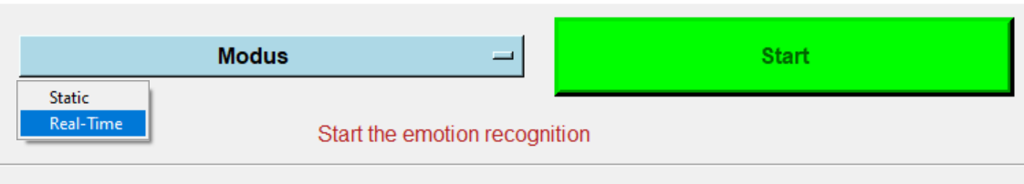
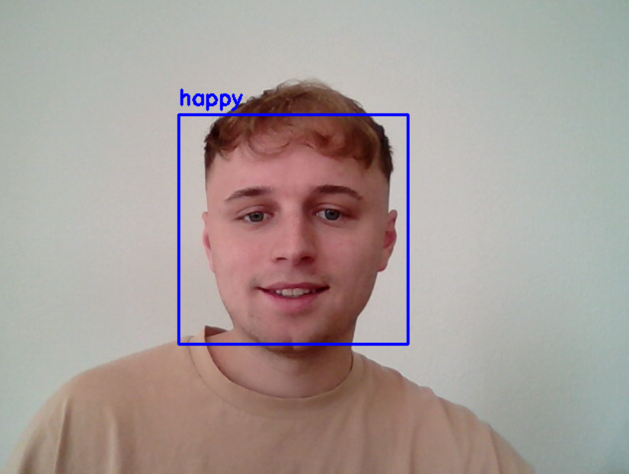
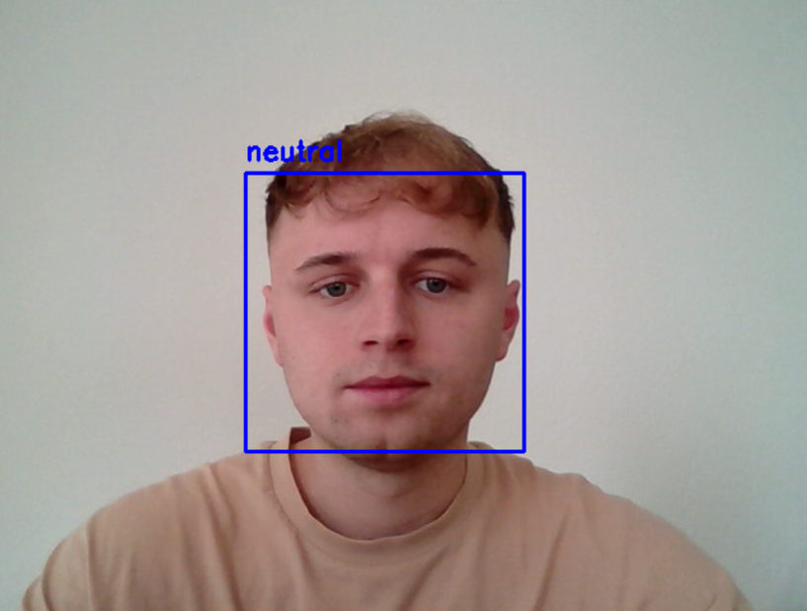
Prototype: Implementation

Slide 15
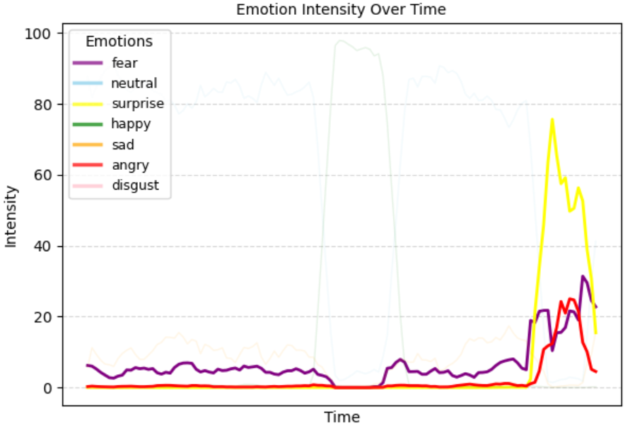
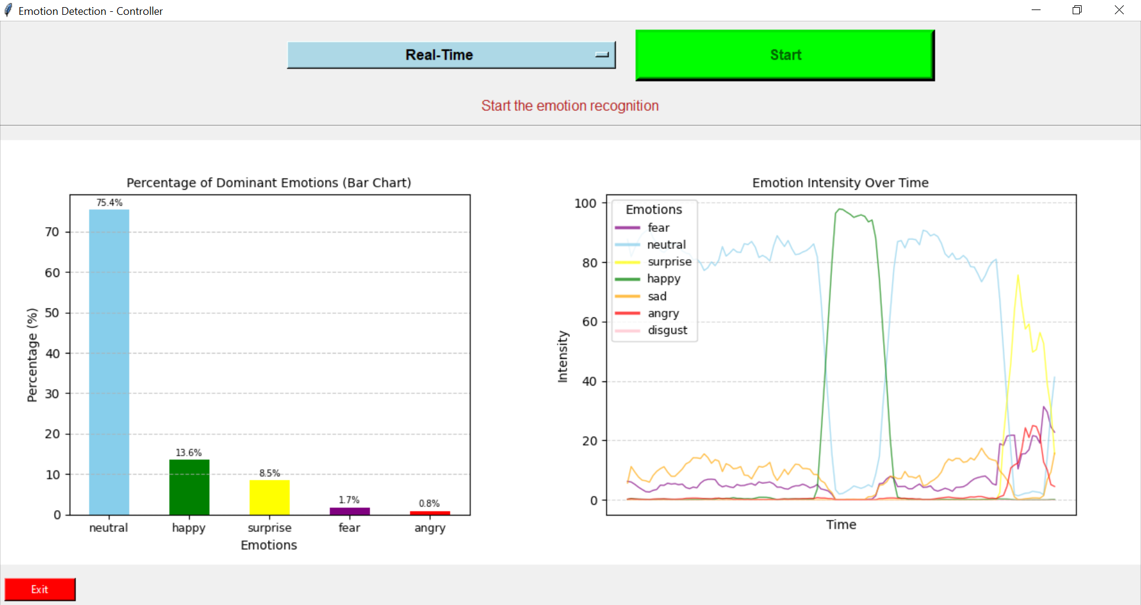

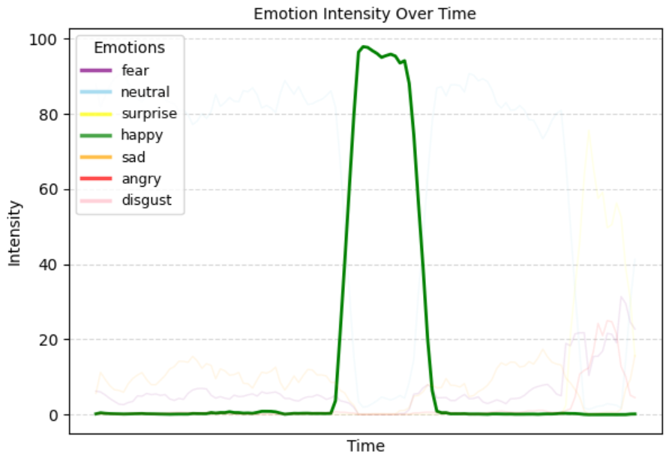
Prototype: Implementation

Slide 16

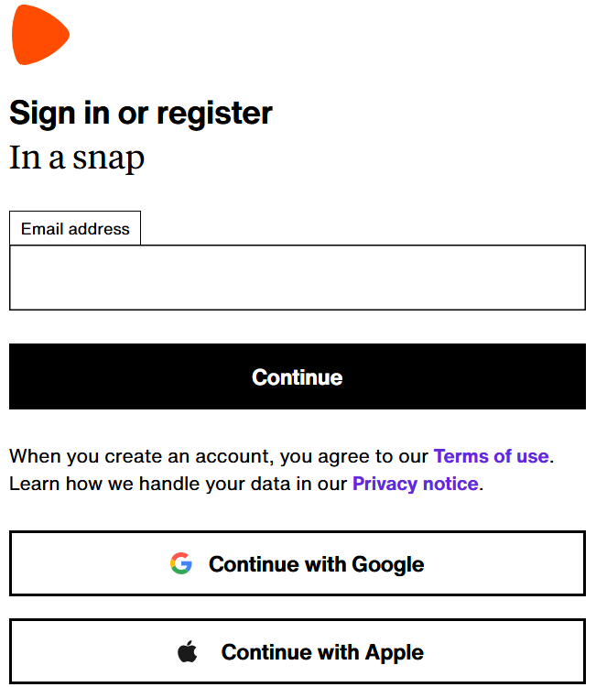
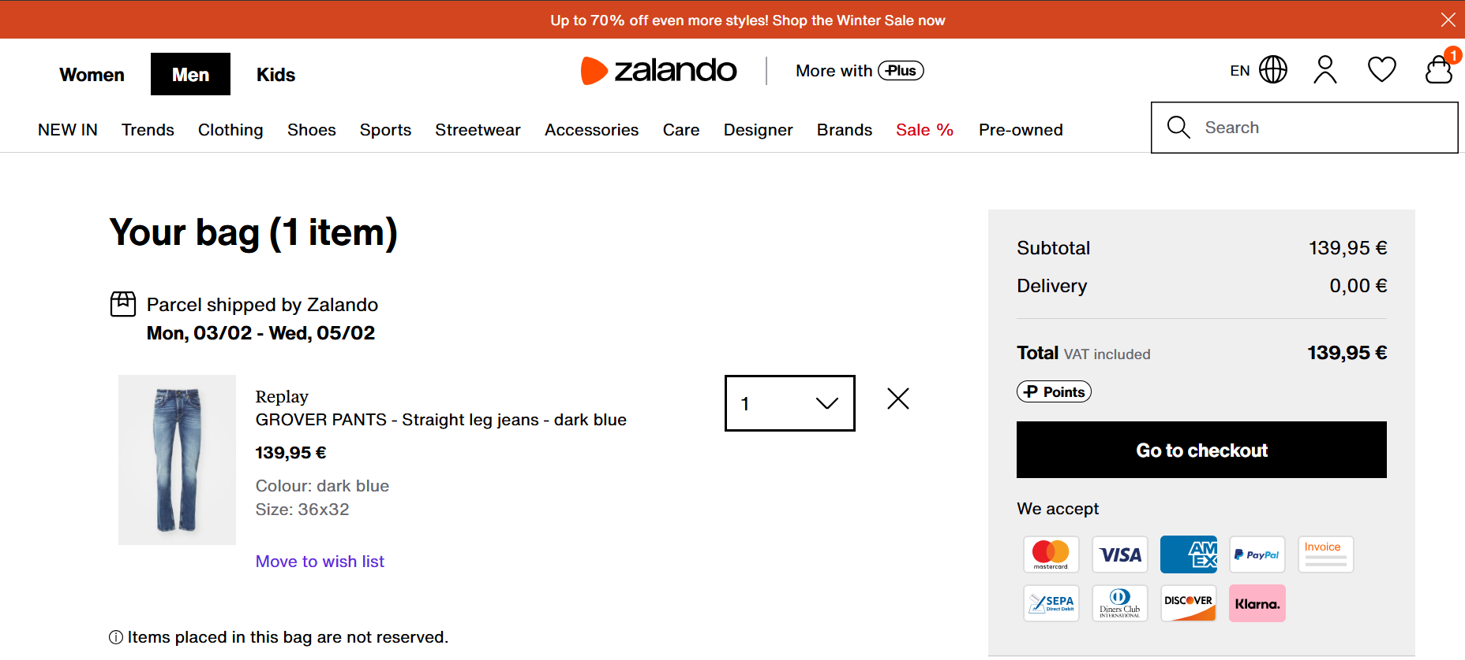

Prototype: Enhancements & Optimizations
Problem: We can only guess based on the time which process the emotion belongs to, for example, most likely the checkout process at the end. However, we don't know for sure as we lack additional information
[3]
[3]

Slide 17


Prototype: Enhancements & Optimizations
Eye tracking
Mouse & Click tracking
Goal: Interpret emotions in combination with concrete user behavior & contextual information

Slide 18

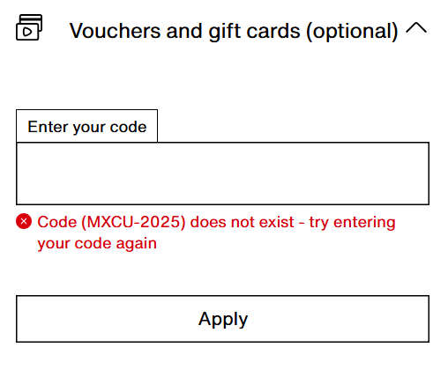
Prototype: Enhancements & Optimizations
Example: A user is angry, tries to apply a discount code and spends more time than usual on the shopping cart page
Use further context to identify the exact pain point
In this case: entering a voucher

Slide 19
Reflection & Limitations
04

Slide 20

Personal Reflection
Strength:
Easy to implement
Valuable insights for usability and helps understand & improve customer satisfaction
(shows the true emotions that you cannot hide)
Very well suited for the use case of recognising expressive emotions (reliable recognition)
Challenges & Limitations:
Very strong/expressive emotions in relation to websites, e.g. disappointment vs. sadness in a sold-out scenario
Most facial expressions on websites are very subtle & fast micro-expressions, which are hard to interprete & recognise
Needs proper lightning & minimal distractions
Laptops/computers requires performance for smooth & effective detection
Recording raises privacy concerns --> ideal for lab environments with user consent

Slide 21
Time for Questions

Slide 22
References - Figures
[1] Synergetic Play Therapy. (n.d.). Emotions from the Inside Out. Retrieved January 28, 2025, from https://synergeticplaytherapy.com/emotions-from-the-inside-out
[2] Wikimedia Commons. (n.d.). Circumplex model of emotion [SVG image]. Retrieved January 28, 2025, from https://commons.wikimedia.org/wiki/File:Circumplex_model_of_emotion.svg
[3] Zalando. (n.d.). Men's Clothing – Shop Fashion Online. Retrieved January 31, 2025, from https://en.zalando.de/men-home/
Icon: created with flaticon (https://www.flaticon.com/de/suche?word=robot)

